Slide 1

Chapter 2: Statistics Introduction to Forecasting Fall 2019

Slide 2
Announcements
HW #1 has been posted on Blackboard
It is due on September 20 at 11:59 pm
Installation instructions for Deep Learning package is also posted
Not needed until second half of course (i.e. after Fall break)
Registration codes have been provided to few students on waitlist
Based on movement in the enrollment with respect to capacity, additional codes will be provided

Slide 3
Outline (for today’s lecture)
Terminology used in forecasting
Mathematical notation
Basic Smoothing filters
Linear filters
Median filters
Formal definition of Stationarity
Autocovariance and Autocorrelation

Slide 4
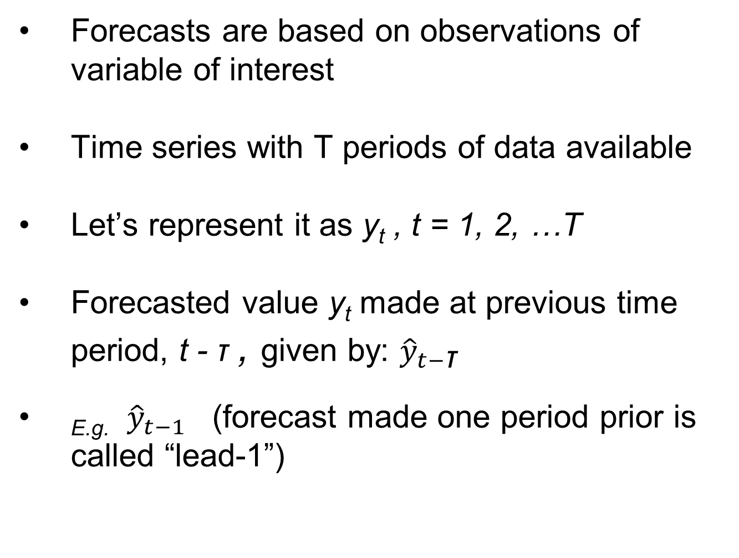
Terminology
Forecasts are based on observations of variable of interest
Time series with T periods of data available
Let’s represent it as y_{t} , t = 1, 2, …T
Forecasted value y_{t} made at previous time period, t - τ , given by: ${\hat{y}}_{t−\text{τ}}$
_{E.g.} ${\hat{y}}_{t−1}$ (forecast made one period prior is called “lead-1”)

Slide 5
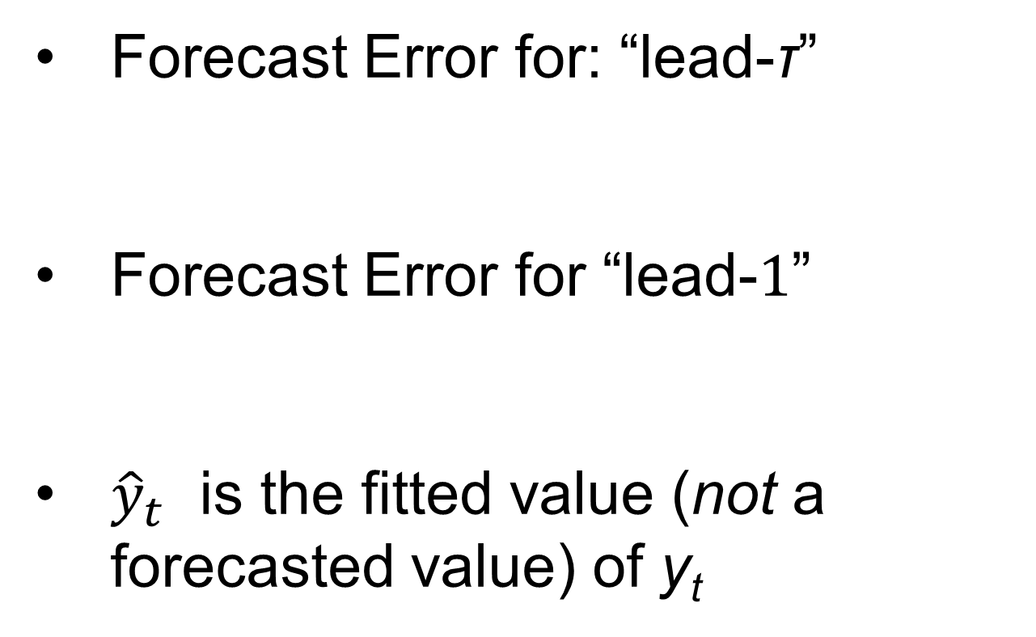
Terminology (Forecast Error)
Forecast Error for: “lead-$\text{τ}$”
Forecast Error for “lead-$1$”
${\hat{y}}_{t}$ is the fitted value (not a forecasted value) of y_{t}

Slide 6
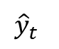
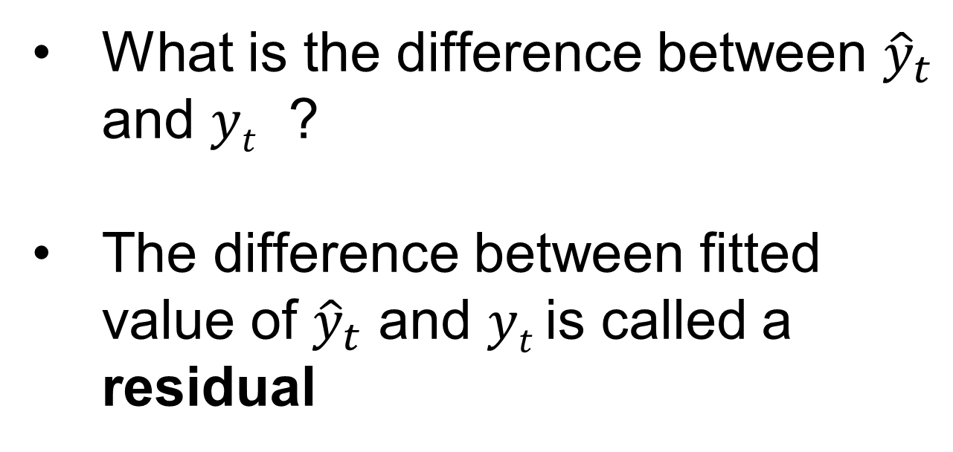
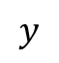
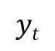
Residuals
What is the difference between ${\hat{y}}_{t}$ and $yt$ ?
The difference between fitted value of ${\hat{y}}_{t}$ and $yt$ is called a residual
$$y$$
$${\hat{y}}_{t}$$
$$yt$$
t

Slide 7
Graphical Displays
Time series plots
basic graphical display for time series data
just a graph of y_{t} versus the time period, t, for t = 1, 2, …, T

Slide 8
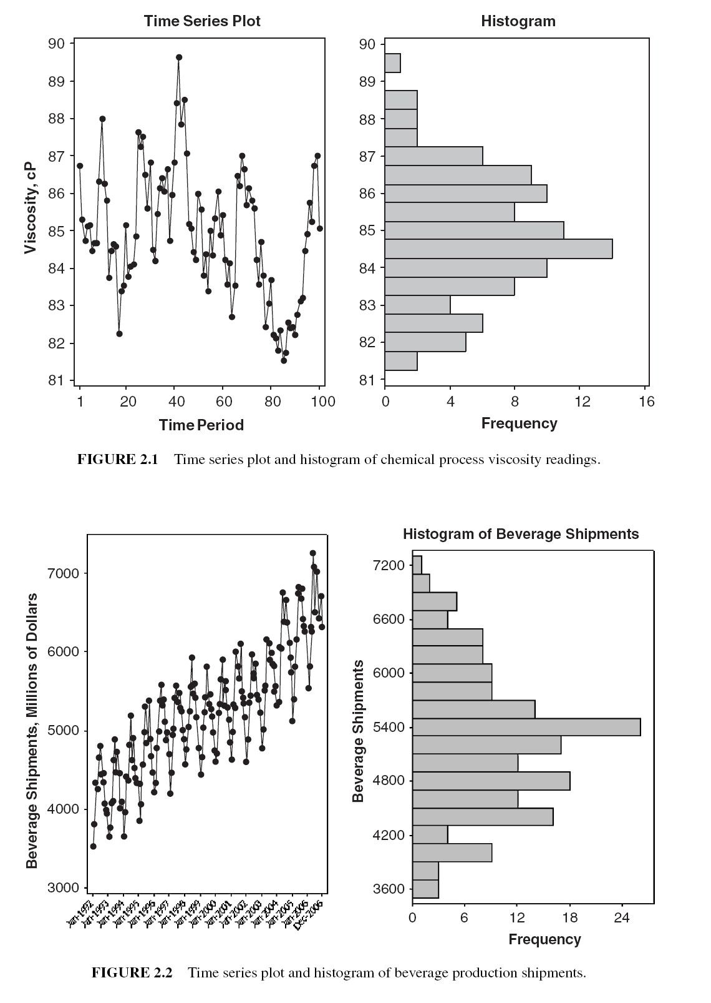
Notice that the histograms look very similar even though the time series behavior is very different
Time series plots

Slide 9
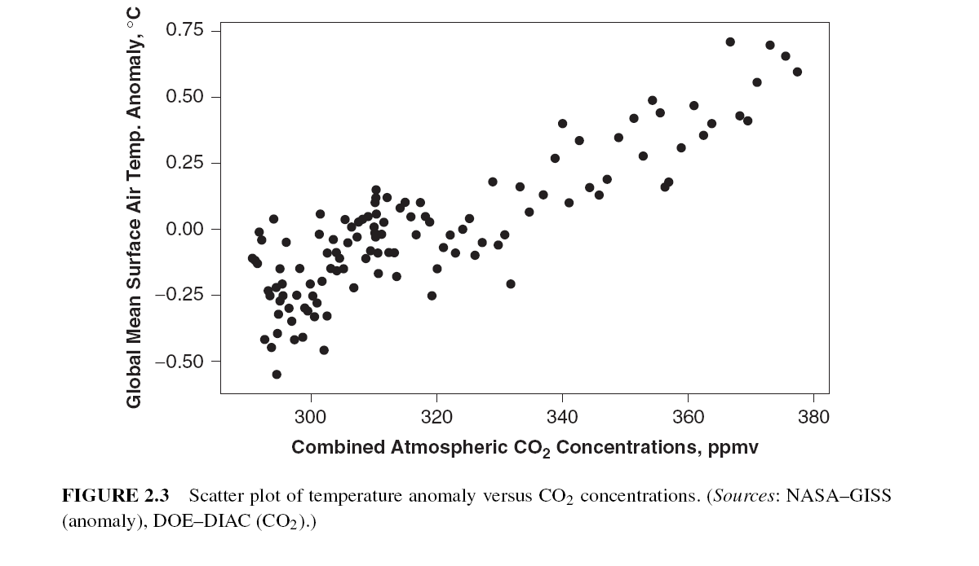
When there are two or more variables, scatter plots can be useful:

Slide 10
Variations of time series plots

Slide 11
Plotting smoothed data
overlay a smoothed version of the original data
simplest and most widely used is the ordinary or simple moving average (M_{T})
moving average has less variability than the original observations; if the variance of an individual observation y_{t} is σ² :
Remember, Var(aX) = a² Var(X)
(assuming y_{t} is independent)

Slide 12
Why is the moving average missing in the first few samples?
Moving average

Slide 13
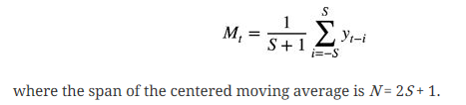
Centered Moving Average
The moving average
S=2 points on either side

Slide 14
Linear Filter (data smoother)
Simple moving average is a linear data smoother, or a linear filter
Replaces each observation y_{t} with a linear combination of other data points
Has equal weights … 1/N in previous example
Alternatively, could use unequal weights …
3 point Hanning filter

Slide 15
Drawback of Linear filters
Obvious disadvantage of a linear filter (i.e. moving average) …
Unusual or erroneous data point or an outlier will dominate the moving average

Slide 16
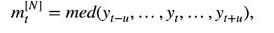
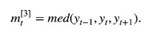
Median filters can smooth data with atypical values
moving medians (also called running medians) are an alternative to moving averages
N= 2u+1 is the filter length
Size 3 median filter

Slide 17
Median filters can smooth data with atypical values
moving median will pass monotone sequences of data unchanged
Also follows a step function in the data
To eliminate a spike, u (median filter length) must be greater than spike duration (length)

Slide 18
Strictly Stationary Time Series
Data is strictly stationary if its properties are NOT affected by a change in time origin
The joint probability density function does not change if the time interval changes
same as

Slide 19
Stationary data

Slide 20
Mean of a Time Series
Given by E(y_{t})=μ(t), similar to:
For a time series, Mean typically is a function of time
However, a time series is Stationary in the mean if
E(y_{t}) = μ(t)=μ, a constant over all time

Slide 21
Variance of a Time Series
The variance σ²(t) of a time series model that is stationary in the mean is given by:
σ2(t)=E[(yt−μ)²]
A time series is stationary in the variance if σ²(t)=σ²
Notes:
https://www.quantstart.com/articles/Serial-Correlation-in-Time-Series-Analysis

Slide 22
(Weakly) Stationary Time-series
If covariance between sequential observations is only a function of the lag, that is, the number of time steps separating each sequential observation.
C_{k}=E[(y_{t}−μ)(y_{t+k}−μ)]
Covariance
k
y_{t}
y_{t+k}
Notes:
https://www.quantstart.com/articles/Serial-Correlation-in-Time-Series-Analysis

Slide 23
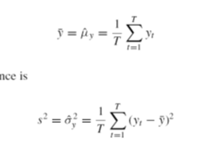
Mean of a Stationary Time-series
Has a constant Mean:
Constant Variance:
Sample Mean and Variance

Slide 24
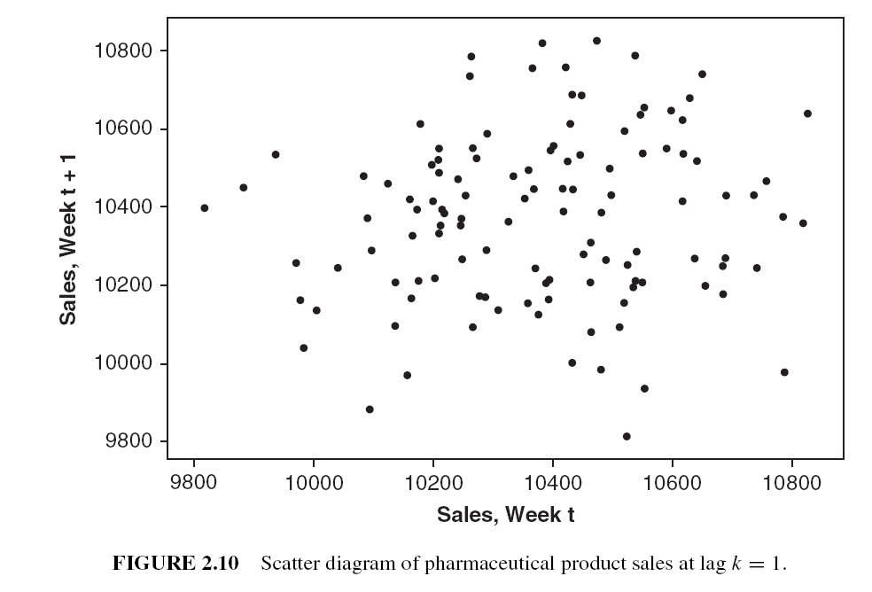
How to visualize correlations within a time series?
Scatter plot of data pairs y_{t} and y_{t+k} separated by interval k
Interval k is called lag
Un-correlated
Positively correlated

Slide 25
Autocovariance and Autocorrelation
Covariance between y_{t} and y_{t+k} is called auto-covariance at lag k, defined by :
For k=0, above equation is variance,
Auto-correlation coefficient at lag k is:
$$Remember, Cov(X1,X2)=E[(X_{1}−μ_{1})(X_{2}−μ_{2})]$$

Slide 26
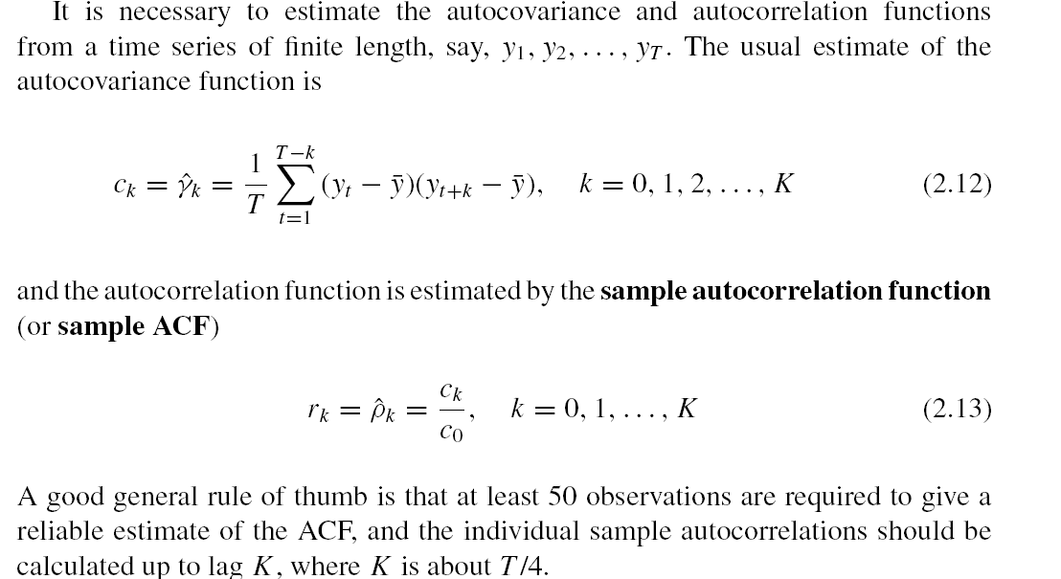
Sample Autocovariance and Autocorrelation function
How to compute the autocovariance?
How to compute autocorrelation function ?
Rule of thumb:
-- Need T=50 observations to compute ACF
-- Sample autocorrelations computed until lag K=T/4

Slide 27
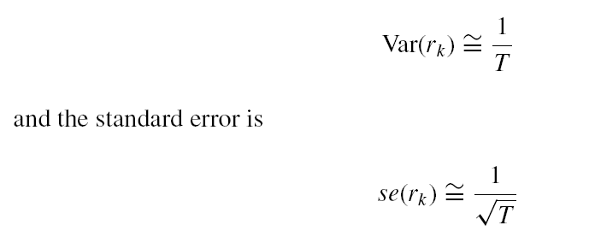
Autocorrelation coefficient
Many times, will need to determine if coefficient at particular lag is zero
To determine if autocorrelation coefficient is zero, compare with the standard error
T = number of values in the time series

Slide 28
Some of the chemical process viscosity data

Slide 29
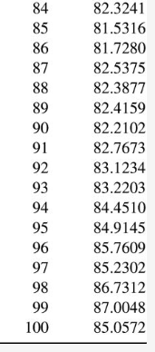
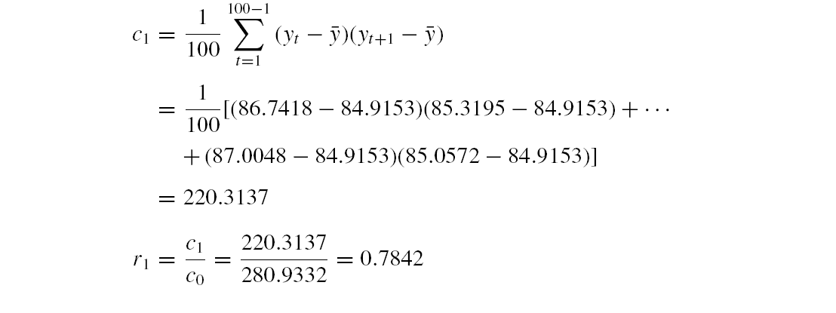
Let’s calculate the Sample Auto-correlation
Mean
y₁
y₁ and y₂

Slide 30
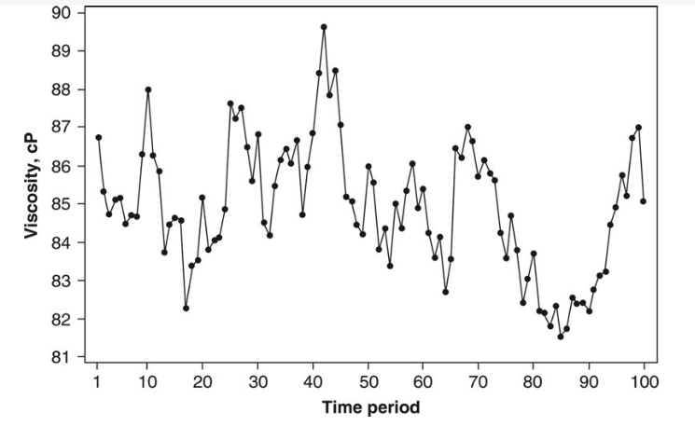
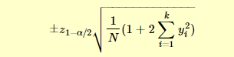
Autocorrelation plots with confidence intervals
Confidence interval
ACF
Time series
Note the rate of decrease or decay in ACF values from 0.78 to 0, followed by a sinusoidal pattern about 0. This ACF pattern is typical of stationary time series
Confidence interval:
(detailed in Chap 5)
(Confidence interval is calculated differently in some programming packages)

Slide 31
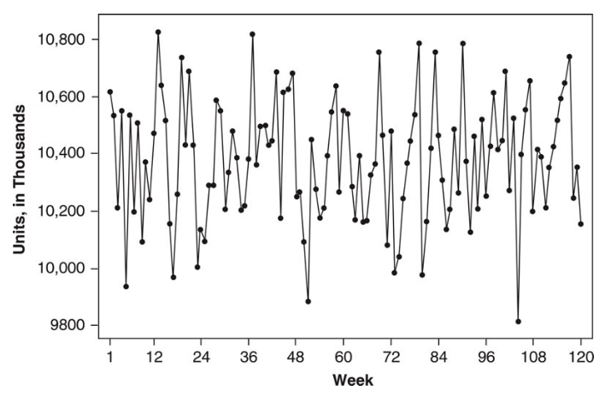
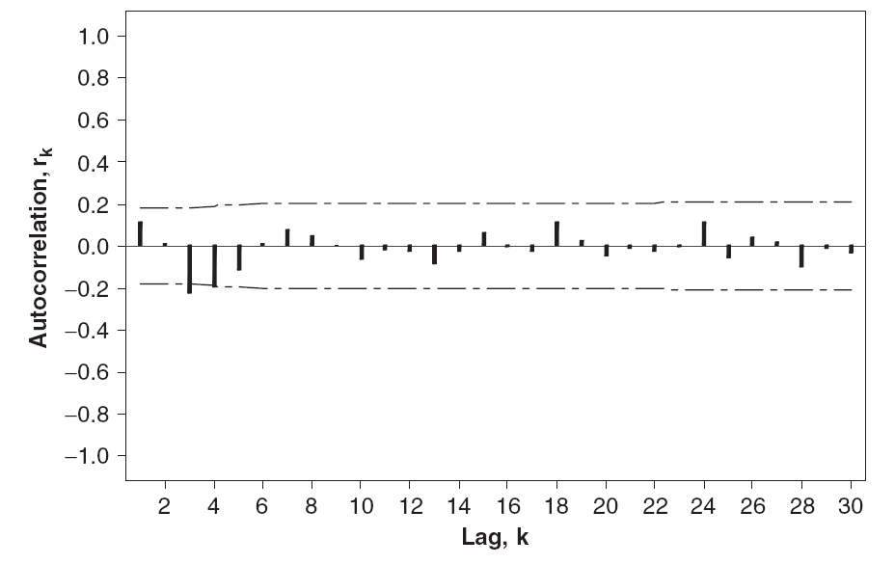
Autocorrelation (ACF) plots
ACFs for a time series of random values with constant mean
The sample ACFs appear randomly positive or negative, with values near zero
ACF
Time series
Plot starts at Lag 1; Lag 0 not shown

Slide 32
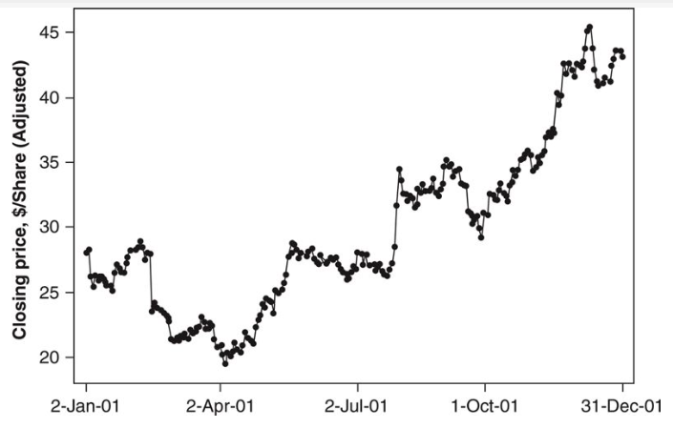
What does the sample ACF of a nonstationary time series look like?
sample ACF is very persistent;
Decays very slowly
large values even at long lags
All are characteristic of a nonstationary time series
Remember: If the sample ACF does not dampen out within about 15 to 20 lags, the time series is nonstationary

Slide 33
Variogram
Variogram measures differences between observations k lags apart
If the time series is stationary,
For a stationary series, ρ_{k} → 0 as k increases, G_{k} reaches 1/(1 – ρ₁)

Slide 34
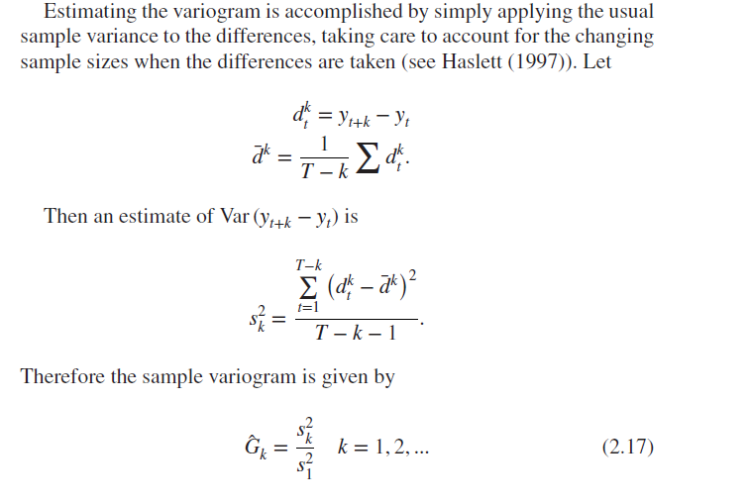
Sample Variogram
Estimating the variogram accomplished by simply applying the usual sample variance to the differences
Note the changing sample sizes when differences are taken

Slide 35
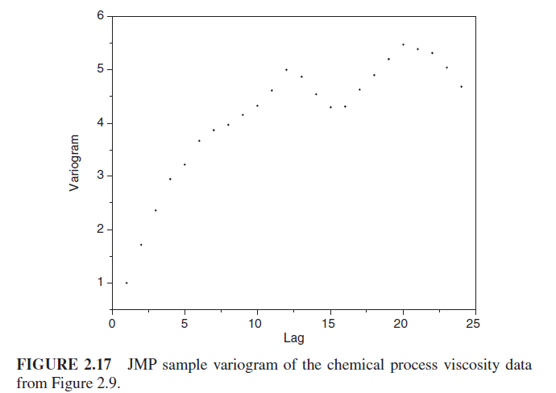
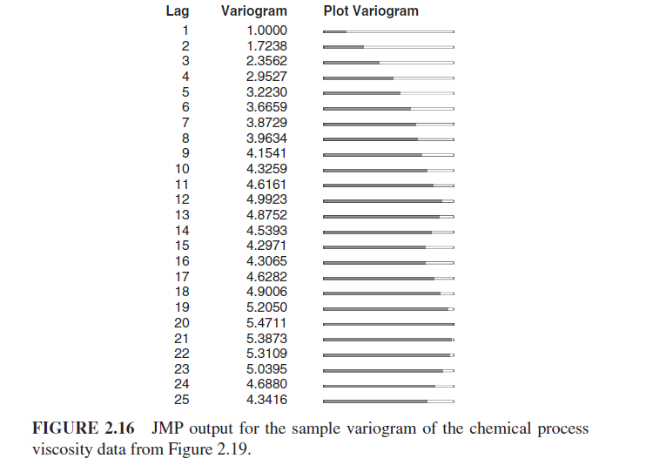
Sample Variogram – Stationary Time Series
Converging to stable
Sample variogram generally converges to a stable level and then fluctuates around it

Slide 36
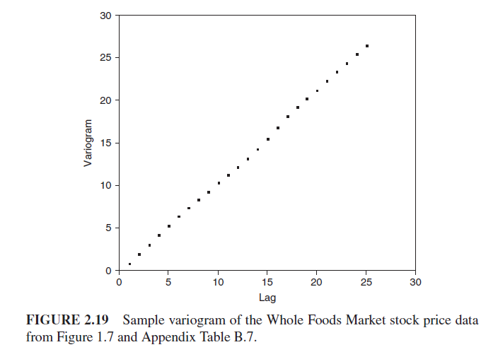
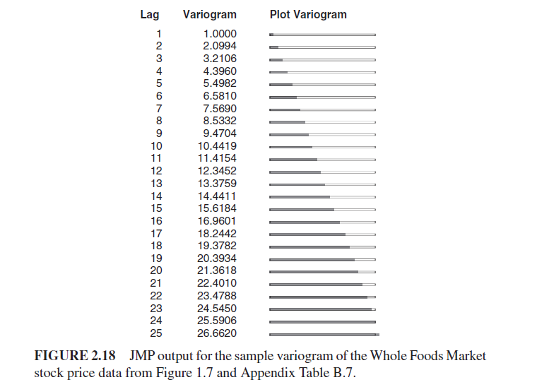
Sample Variogram – Non-Stationary Time Series
Sample variogram increases monotonically for all 25 lags → Strong indication that the time series is nonstationary

Slide 37
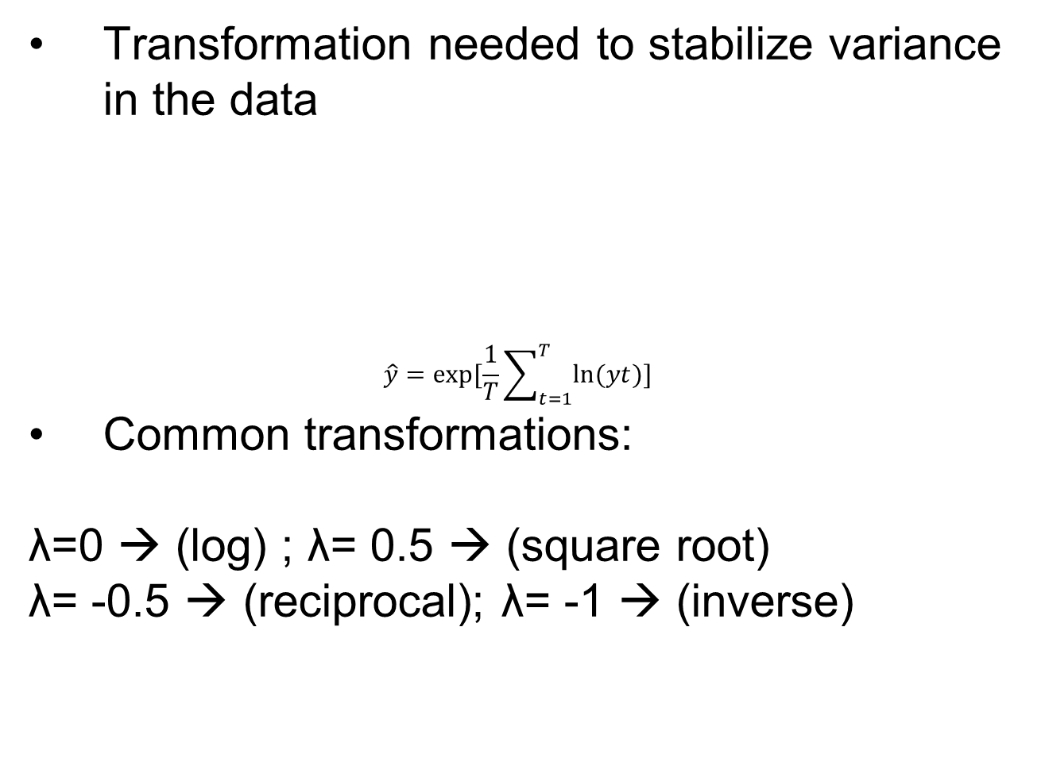
Data Transformation and Adjustments
Transformation needed to stabilize variance in the data
$$\hat{y}=exp⁡[\frac{1}{T}\sum_{t=1}^{T}{ln⁡(yt)]}$$
Common transformations:
λ=0 → (log) ; λ= 0.5 → (square root)
λ= -0.5 → (reciprocal); λ= -1 → (inverse)

Slide 38
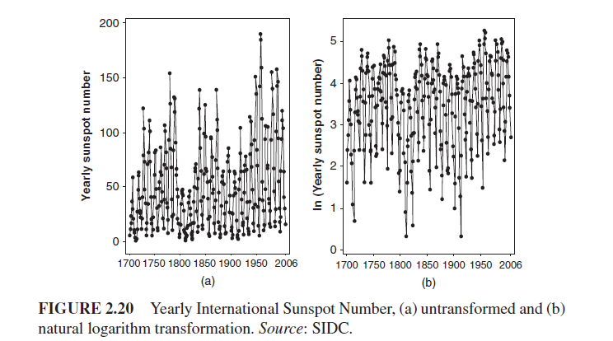
Transformed Data

Slide 39
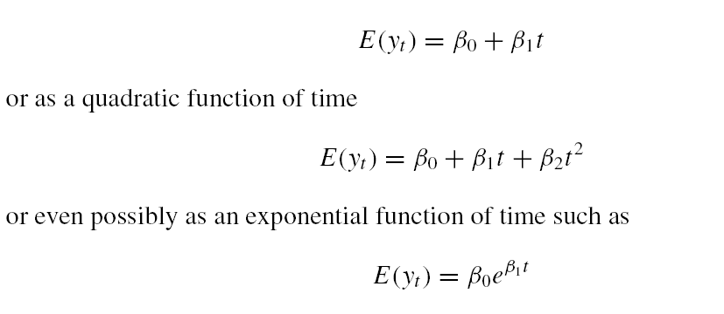
Trend and Seasonal Adjustments
Two widely used adjustments: Trend and Seasonal
Time series with trend is non-stationary
One way to remove trend is regression modeling
With a trend, mean of y_{t} changes linearly with time

Slide 41
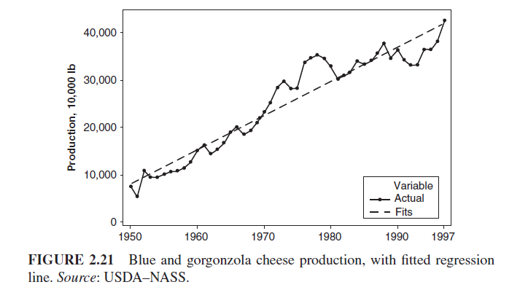

Slide 42
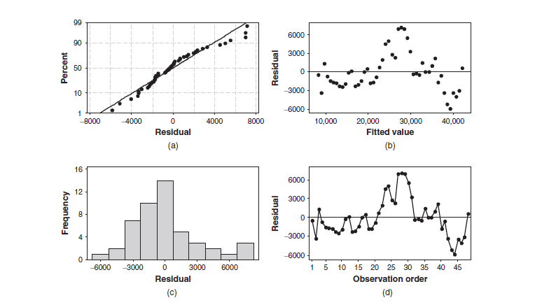
Fig. 2.22
Structure to the residuals
Structure to residuals indicate linear fit is not adequate … implies model error

Slide 43
Removing trend by differencing
Difference the data: apply difference operator
or, a backshift operator (B) , By_{t} = y_{t-1}
Second order difference can also be computed:
y_{t}
y_{t} - y_{t-1}

Slide 44
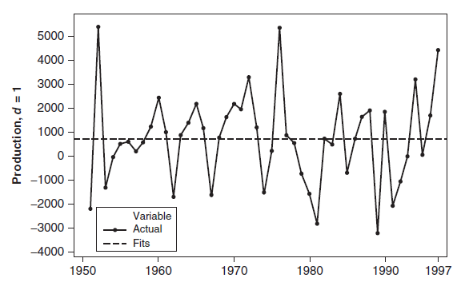
Removing trend by differencing

Slide 45
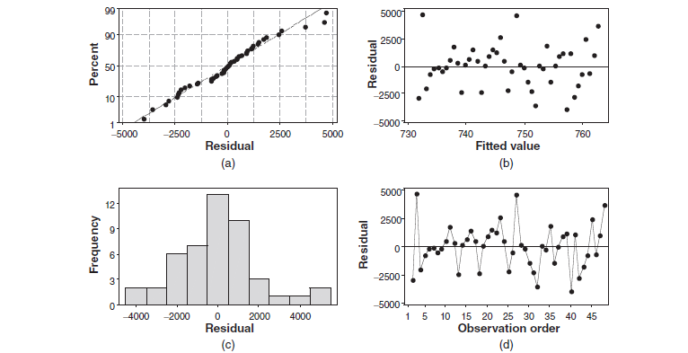
Residual plots after differencing

Slide 46
Removing seasonality and trend
Trend and seasonal are present in many time series
Differencing can be used to remove seasonality
Lag d difference defined as :
To remove annual seasonality (d=12):

Slide 47
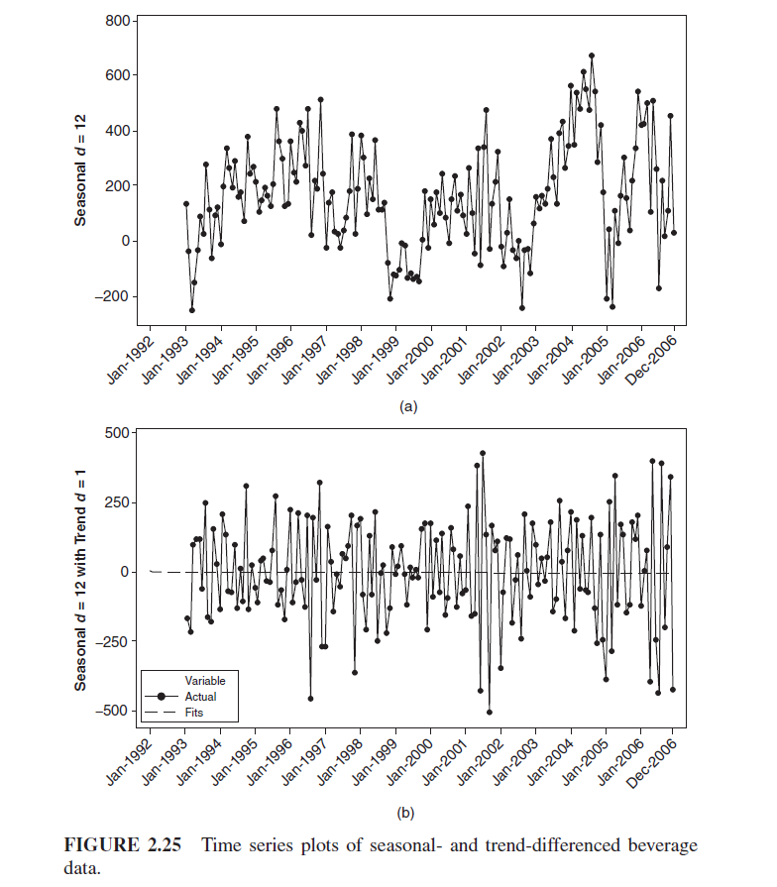
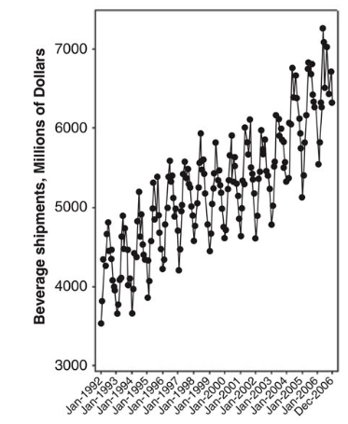
Seasonal-differenced
Seasonal and Trend
Time series
Trend-differenced
Slope = 0

Slide 48
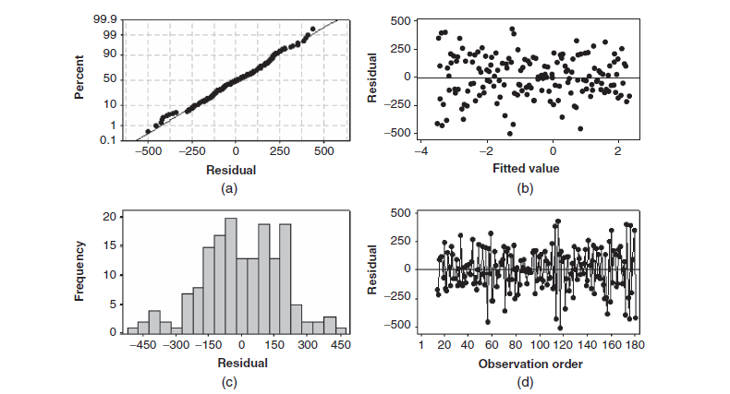
Examination of the residual plots does not reveal any problems with the linear trend model fit to the differenced data.

Slide 49
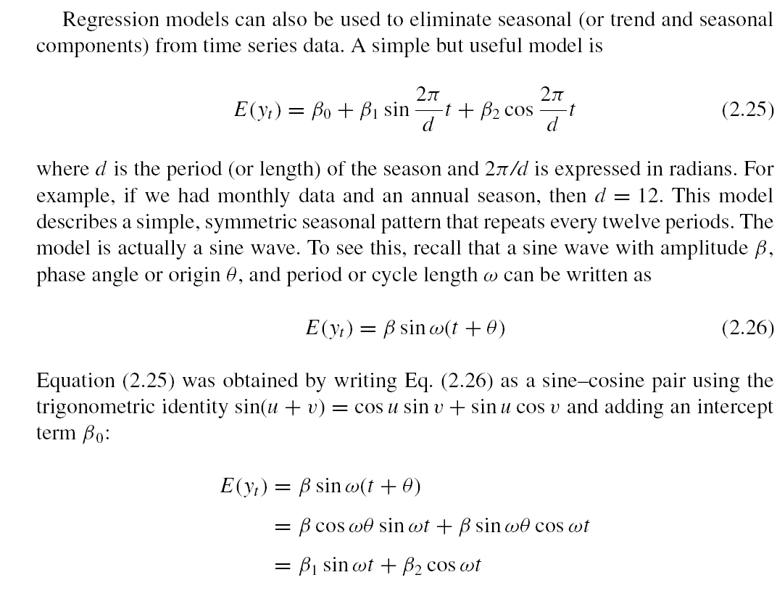

Slide 51
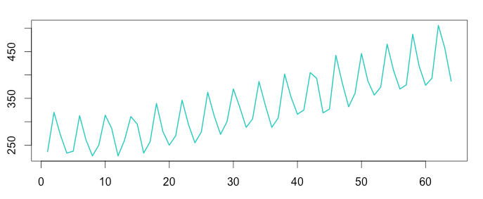
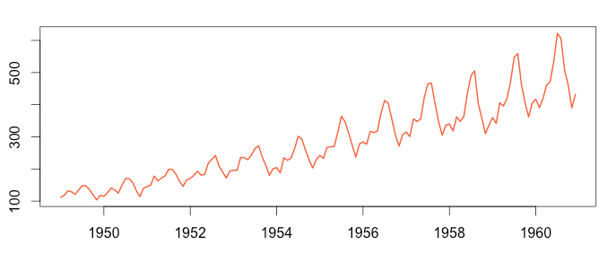
Classical Decomposition Approach
Decompose time series into seasonal, trend, and random error
S_{t} = seasonal component; T_{t} = trend; ε_{t} = error
(Additive model)
Seasonal variation is constant
(Multiplicative model)
Seasonal variation increases with time

Slide 52
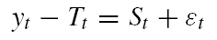
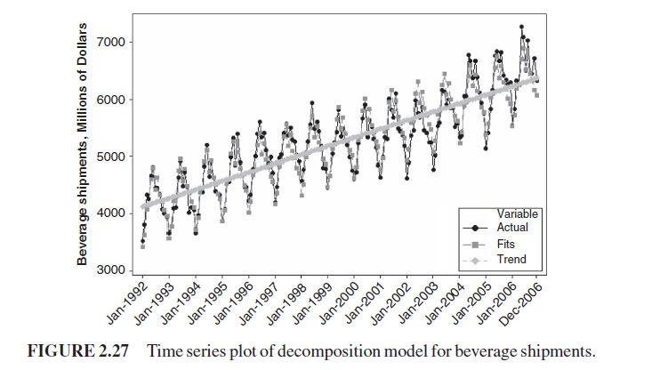
Classical Decomposition Approach
Estimate trend component, and remove it :
Now, can estimate the seasonal indices, i.e.
January seasonal factors are averaged to produce a January season index; all of the February seasonal factors are averaged to produce a February season index; and so on.
T_{t} =

Slide 53
Time series Decomposition
What type (multiplicative or additive) is it ?

Slide 54
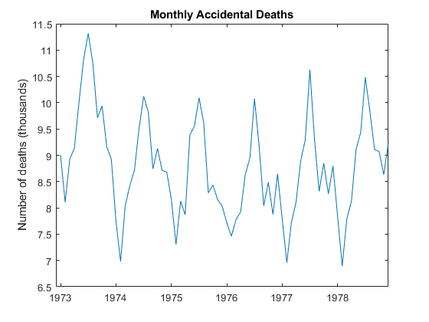
Example: Time Series Decomposition
The data exhibits a strong seasonal component with periodicity 12.

Slide 55
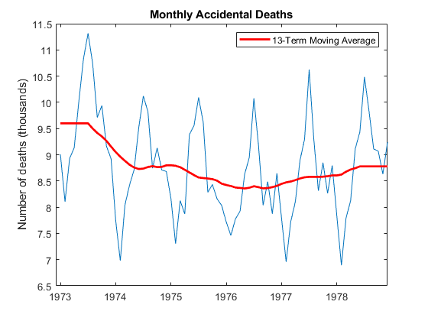
Example: Time Series Decomposition
Estimate the Trend: Apply a 13-term moving average (Why 13?)
Repeated values

Slide 56
Example: Time Series Decomposition
Remove the Trend ;

Slide 57
Example: Time Series Decomposition
Apply a seasonal filter – estimate the seasonal indices
Calculate Average for each month of the year (from 1973-1979)
Replicate 6 times
Replicate
1973
1974
Dec 1979
Jan 1973

Slide 58
Example: Time Series Decomposition
Compute the residuals
-
=
Residuals

Slide 59
Example: Time Series Decomposition
Alternatively, remove seasonal component from original to look at at
-
=
Original
Seasonal index
A Quadratic trend is clearly visible after removing the seasonality

Slide 60
Compare Fitted value with Raw Data
Value
Time

Slide 61
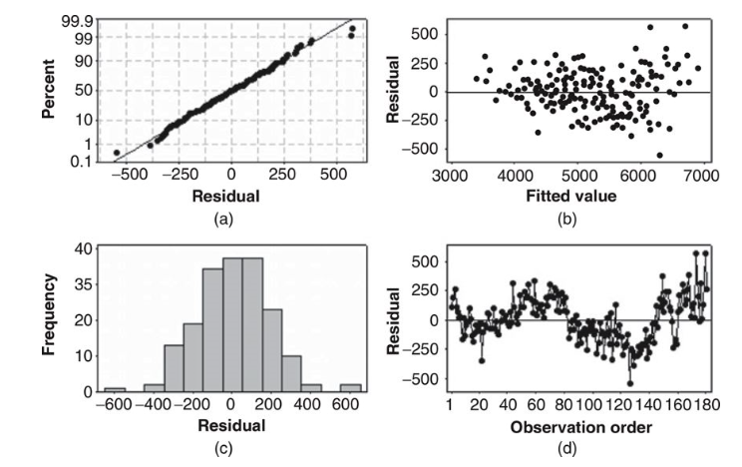
Review of Performance (Original Data)
Increased variance

Slide 62
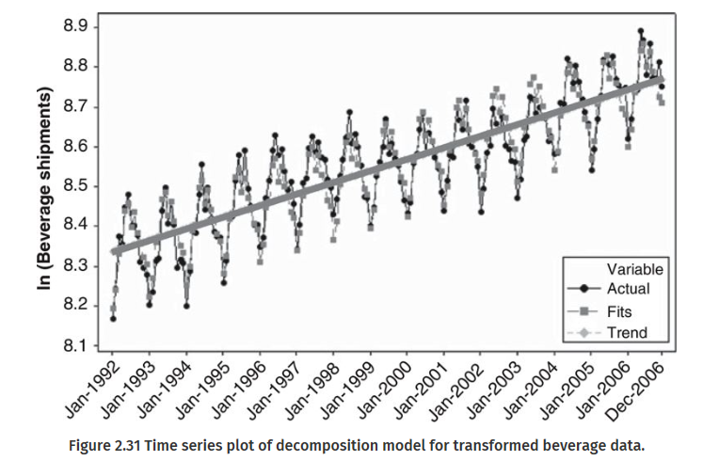
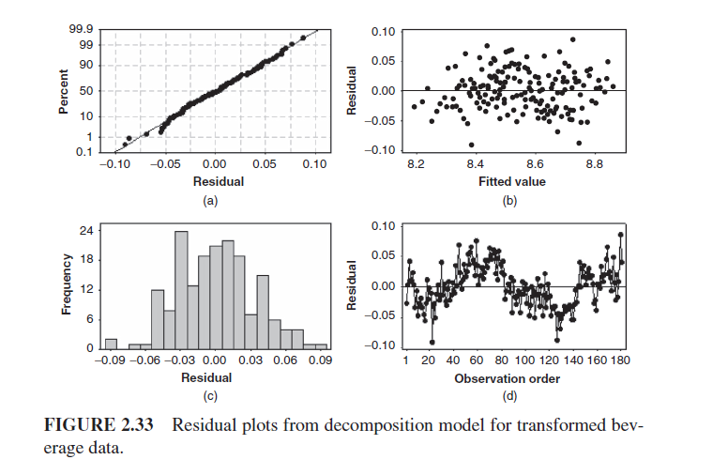
Review of Performance (Log Data)
Log transformed

Slide 63
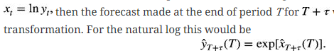
General Approach to Time Series Modeling and Forecasting
Plot the time series → determine its basic features
Check if trend and seasonality is present?
Eliminate any trend or seasonal components
Use differencing or fit an appropriate model to the data
Develop a forecasting model for the residuals
Multiple models could be applied; might need to choose from multiple
Validate the performance of the model (or models) from the previous step
Apply split-sample or cross-validation procedure
Reverse any transformations applied, e.g. if , change to

Slide 64
General Approach to Time Series Modeling and Forecasting
If prediction intervals are desired for the forecast
Apply transformations and construct prediction intervals for the residuals
Then, reverse the transformations made to produce the residuals
Develop and implement a procedure for monitoring the forecast
Ensures that deterioration in performance will be detected reasonably quickly

Slide 65
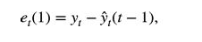
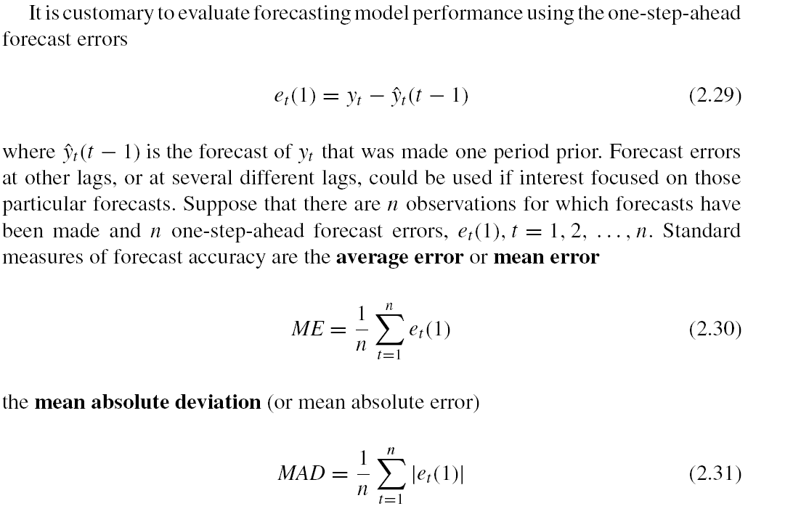
Evaluating and Monitoring Forecast Performance
Evaluate using one-step ahead forecast errors
Suppose we need to evaluate error at n different time points:
Measure of bias
Mean error

Slide 66
Evaluating and Monitoring Forecast Performance
Suppose we need to evaluate error at n different time points:
Measures of variability

Slide 67

Measure of variability
MSE is measure of variability
If errors are normally distributed, standard deviation is related to MAD

Slide 68

Relative Forecast Error
relative forecast error (in percent):
Mean percent errors …

Slide 69
Why do we need relative forecast errors ?
Absolute values are harder to compare
If we were forecasting demand for electricity in Phoenix during the summer, the units would be megawatts (MW)
If the MAD for the forecast error during summer months was 5 MW, we might not know whether this was a large forecast error or a relatively small one
However, knowing that the relative or percent forecast error or the MAPE is 3% (say) can be much more meaningful than knowing that the MAD is 5 MW.
Note that the relative or percent forecast error only makes sense if the time series y_{t} does not contain zero values.

Slide 70

Normality of forecast errors
Forecast errors deviate somewhat from the straight line
→ Normal distribution is not a perfect model for the distribution of forecast errors

Slide 71


ACF of residuals
1.96/sqrt(T), where T= no of samples
sample ACF of the forecast error is like the ACF of random data;
No large “spikes” on the sample ACF at low lag

Slide 72

How to test if autocorrelation values are significant
Set a significance level, α= 0.05
Null hypothesis is autocorrelation values are zero
Compute the Z statistic at chosen α, Z_{α/2}= 1.96
If auto-correlation value r_{k *}sqrt(T) > Z_{α/2}, reject the null hypothesis → autocorrelation values are not zero

